Slide 1


CORPORATE INTERNSHIP PROGRAMME
AI enabled election operations intelligence system for real time workflow monitoring and exception management at Kantar
Swati Bahety
PGDM 2025-2027 | Marketing Major | Operations Minor
Fortune Institute of International Business (FIIB)
Primary Research Intern | 14 April 2026 - 3 July 2026

Slide 2
CONTEXT
Kantar’s election operations sit where data quality, speed and decision-making converge.
The report places the internship in the Market Research, Insights and Analytics industry and the Election Research & Operations business line.
01
02
03
What Kantar does
Business context
Why this internship mattered
Election operations require accurate, timely constituency reporting amid high coordination pressure and varying ECI result-release times.
Provides research, analytics and operational intelligence to support informed business decisions.
The role exposed the operational gap between live data synchronization and team-level visibility.
Industry: Market Research, Insights & Analytics | Business line: Election Research & Operations Management
Source: CIP report, Industry and Organizational Context.
FIIB | Corporate Internship Programme | Kantar
02

Slide 3
ROLE
As a Primary Research Intern, I worked across the live election reporting workflow.
Monitor
Synchronize
Validate
Coordinate
Live ECI updates
Constituency activity
Round-wise progress
Constituency data
Update timelines
Reporting records
SLA compliance
Data quality checks
Workflow exceptions
RAs and TLs
Escalation support
Operational continuity
Business interface
Research Associates (data synchronization) <-> Team Leaders (monitoring, validation and escalation)
FIIB | Corporate Internship Programme | Kantar
03

Slide 4
PROJECT
The project translated an observed workflow gap into an AI-enabled operational intelligence prototype.
01
Business context
Live constituency updates under a two-minute SLA
02
Operational challenge
Manual monitoring of rounds, delays and exceptions across constituencies
03
Analytical diagnosis
Process mapping and gap analysis identified visibility and intervention delays
04
Technology-enabled solution
Rule-based monitoring framework with centralized data, detection, alerts and dashboard
Focus: real-time monitoring, exception detection, centralized visibility and decision support - not election prediction.
FIIB | Corporate Internship Programme | Kantar
04

Slide 5
PROBLEM 1
Manual monitoring increased the effort required to identify operational exceptions.
Team Leaders had to continuously review multiple constituency records, reporting progress and synchronization status.
ECI update
Multiple records
Manual checking
TL validation
Exception identification
Why it happened
Monitoring responsibilities were distributed across individual constituency records during a dynamic, high-volume counting process.
Business consequence
More repetitive checking, higher monitoring load and less capacity to respond proactively as operational volume increased.
FIIB | Corporate Internship Programme | Kantar
05

Slide 6
PROBLEM 2
Missing rounds were a critical completeness risk that was difficult to spot manually.
Sequential counting rounds could be skipped because of reporting delays or synchronization inconsistencies.
ROUND 1
ROUND 2
ROUND 3
ROUND 4
ROUND 5
ROUND 6
Received
Received
Received
Missing
Received
Received
Why it happened
Business consequence
Team Leaders had to compare sequences manually across numerous constituencies.
Detection could be delayed, affecting reporting completeness and workflow accuracy.
Report example: received 1 -> 2 -> 3 -> 5 -> 6; expected 1 -> 2 -> 3 -> 4 -> 5 -> 6.
FIIB | Corporate Internship Programme | Kantar
06

Slide 7
PROBLEM 3
A strict two-minute SLA made delayed updates an operational intervention risk.
Research Associates were expected to synchronize constituency updates almost immediately after ECI information became available.
ECI data
goes live
RA update
Monitoring
Validation
Escalation
2-minute SLA window
Why manual tracking was difficult
Monitoring timestamps across multiple constituencies increased the likelihood of delayed intervention when exceptions exceeded the threshold.
SLA rule in the report: SLA Delay = Current Time - Last Update Time; if delay > 2 minutes, alert.
FIIB | Corporate Internship Programme | Kantar
07

Slide 8
PROBLEM 4
Fragmented records made it hard to answer a simple operational question: what is happening now?
Constituency A
Constituency B
Constituency C
RA1 / RA2
What is happening
right now?
Rounds
Status
Exceptions
No single, consolidated monitoring view
Visibility gap
Information scattered across records limited situational awareness and slowed identification of constituencies requiring immediate attention.
FIIB | Corporate Internship Programme | Kantar
08

Slide 9
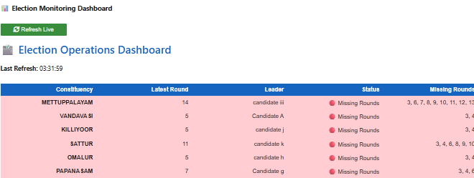
SOLUTION 1
The Live Monitoring Dashboard centralized constituency status, progress and exceptions in one view.
Implementation evidence from the CIP report; screenshot is reproduced from the developed prototype.
One operational view
Constituency status, latest round, leader, missing rounds and SLA status.
Attention focus
Team Leaders can identify constituencies requiring attention without reviewing each record separately.
Demonstrated capability
Prototype dashboard shown to the Corporate Mentor; not an organizational deployment.
Evidence: report Figure 3 / Proof 3 - Live Monitoring Dashboard.
FIIB | Corporate Internship Programme | Kantar
09

Slide 10
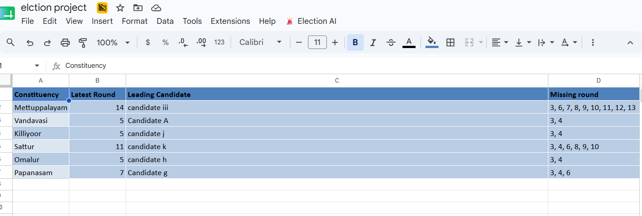
SOLUTION 2
The Missing Round Detection Engine automated sequence validation and exception flagging.
The prototype compares reported rounds against the expected sequential pattern.
Input data
Expected round
Actual round
Compare
Missing round detected
Exception flag
Prototype validation
Input: rounds available = 1, 2, 4
Expected output: missing round = 3
Actual result: successfully detected
Status: PASS
Live database evidence: missing-round field is surfaced alongside constituency data.
FIIB | Corporate Internship Programme | Kantar
10

Slide 11
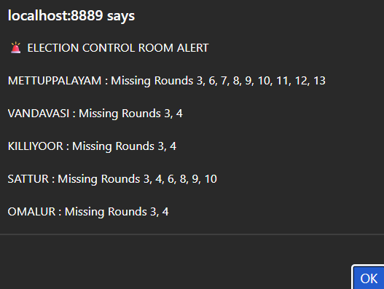
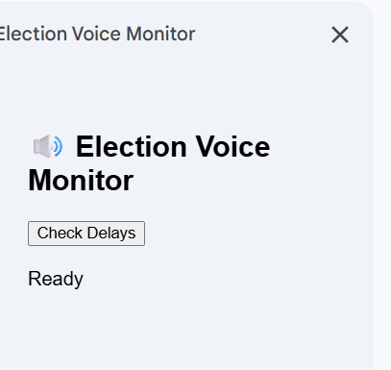
SLA & ALERTS
The SLA Monitoring and Voice Alert modules turned timestamp exceptions into immediate attention signals.
The system monitors the two-minute threshold and generates alerts for delays, missing rounds and critical workflow exceptions.
Round update
Time difference
SLA check
Normal / warning / critical
Alert
Prototype boundary
Voice alerts operate within the Jupyter monitoring environment; broader notifications were future scope.
Validation evidence: update delay > 2 minutes -> voice alert generated (PASS).
FIIB | Corporate Internship Programme | Kantar
11

Slide 12
SOLUTION 4
The framework converted fragmented monitoring into an exception-driven operational intelligence workflow.
Six implemented modules connect a live collaborative data layer to team-level action.
ECI updates
Research Associate
Google Sheet synchronization
Rule-based operational intelligence layer
Election GPT
Live Monitoring
Dashboard
Goal Meter
Missing Round
Detection
SLA Monitoring
Voice Alert
System
Team Leader action: prioritize, coordinate, resolve
Implementation evidence: six modules were demonstrated to the Corporate Mentor (Level 1 - Demonstrated in Context).
FIIB | Corporate Internship Programme | Kantar
12

Slide 13
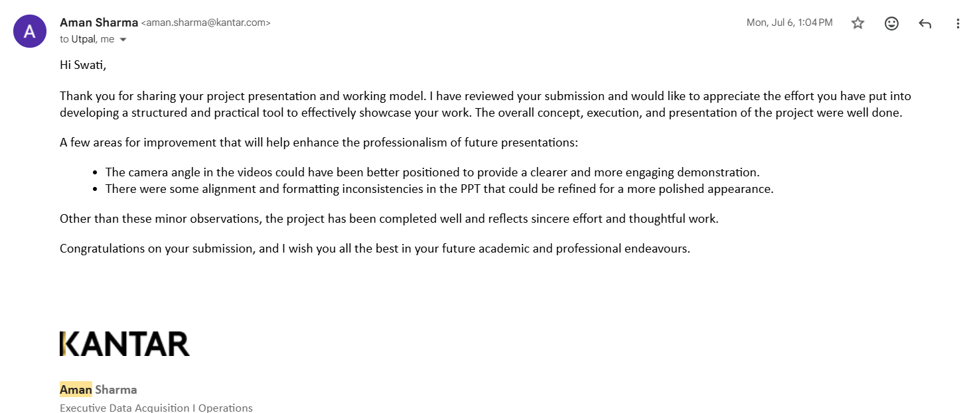
FEEDBACK
Corporate-Mentor feedback validated the dashboard’s visibility and exception-management value.
The report records a demonstrated-in-context prototype, not confirmed team-level or organizational adoption.
What it validated
Centralized visibility, automated repetitive monitoring and faster exception identification.
What I improved
Feedback and suggestions were incorporated into the final presentation quality and documentation.
What remained
Broader implementation would require integration with operational systems and organizational approvals.
FIIB | Corporate Internship Programme | Kantar
13

Slide 14
CAPABILITY
The internship developed a balanced capability set across technology, analysis and operations.
Capabilities below are drawn from the development work and learning outcomes documented in the CIP report.
Technical
Analytical
Professional
Python and Pandas
Process mapping
Workflow coordination
Google Sheets integration
Operational gap analysis
Communication with stakeholders
Jupyter-based dashboarding
Exception detection
Time management
Rule-based automation
SLA monitoring
Team collaboration
Voice alert generation
Decision-support thinking
Project presentation
The project integrated operations management principles with technology-driven monitoring in a real-time workflow context.
FIIB | Corporate Internship Programme | Kantar
14

Slide 15
CLOSING
The internship taught me to convert operational complexity into structured, data-driven action.
01
Business understanding
02
Problem solving
Real-time workflows, constituency coordination and SLA-driven operations.
Breaking a manual monitoring challenge into identifiable process gaps.
03
Analytical thinking
04
Professional growth
Using data, exception logic and visibility to focus follow-up.
Working with stakeholders, deadlines and real-world operating constraints.
THANK YOU
FINAL PRESENTATION / WORKING MODEL
[http://localhost:8888/lab/tree/google%20sheet.ipynb ]
https://docs.google.com/spreadsheets/d/1-fkXH6w6ehXRa6AXP qProhjAeTWVj8BmMJHwhZa5Ho/edit?usp=sharing
FIIB | Corporate Internship Programme | Kantar
15

